Slide 1
1

Slide 2

APPLIED CRYPTOGRAPHY
Lecture 49
2

Slide 3
Digital signature Standard
Adopted by NISt
3

Slide 4
Contents
Terms and Definitions
Mathematical Symbols
Setup
DSS working

Slide 5
Terms
Certificate
Certification Authority
Claimed signatory
Digital signature
Domain parameter seed
Domain parameters
Entity
Hash function
Key
Key pair

Slide 6
Mathematical symbols
a mod n
Counter
domain_parameter_seed
Seedlen
SHAx(M)

Slide 7
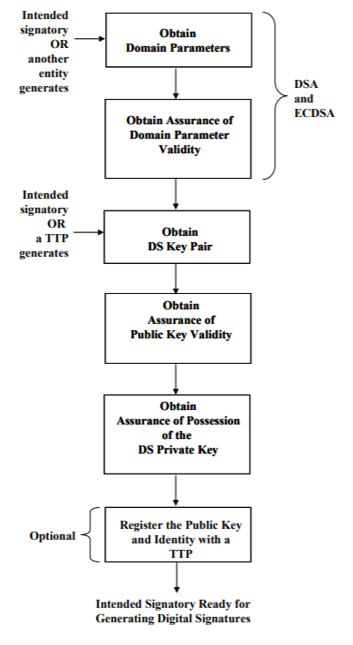
setup

Slide 8
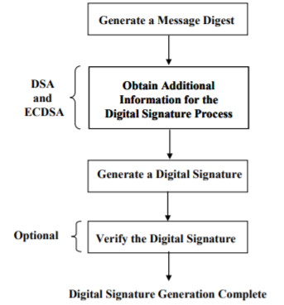
Digital Signature Standard (DSS)
Digital signature Generation

Slide 9
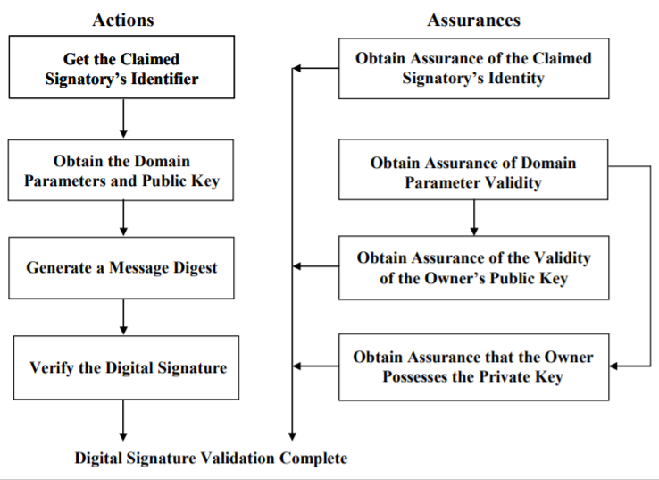
Verification and validation

Slide 10
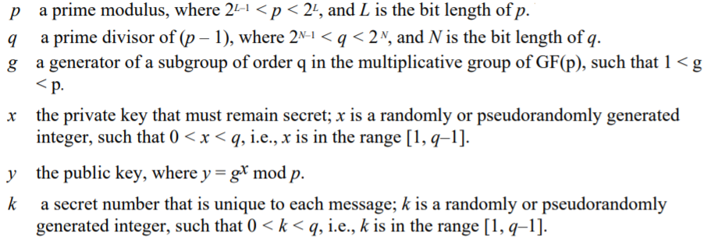
DSA Domain Parameters

Slide 11
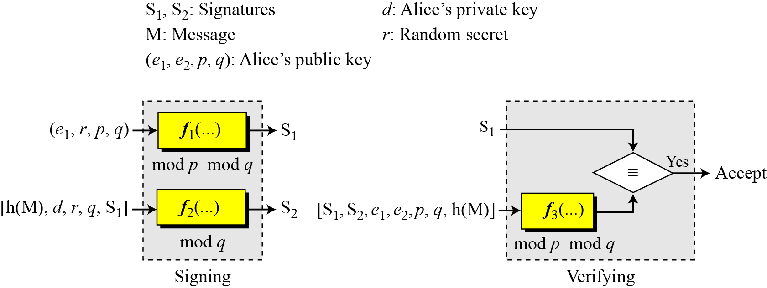
General idea behind DSS scheme

Slide 12
Key generation
Alice chooses primes p and q.
Alice uses <Z_{p}*, × > and <Z_{q}*, ×>.
Alice creates e₁ to be the qth root of 1 modulo p.
Alice chooses d and calculates e₂ = e₁^{d}.
Alice’s public key is (e₁, e₂, p, q); her private key is (d).

Slide 13
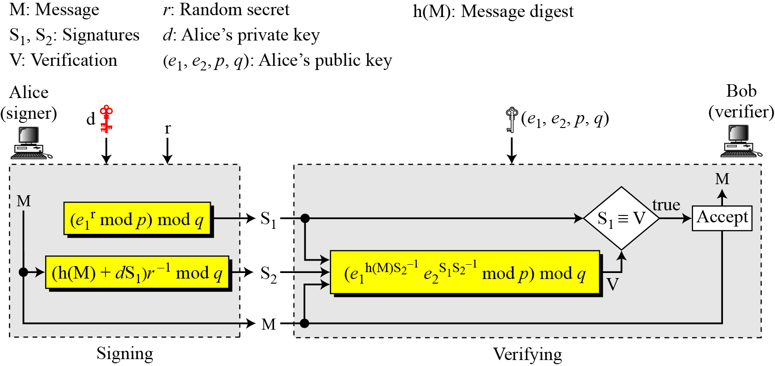
Verifying and Signing

Slide 14
Alice chooses q = 101 and p = 8081. Alice selects e₀ = 3 and calculates e¹ = e₀ ^{(p−1)/q} mod p = 6968. Alice chooses d = 61 as the private key and calculates e₂ = e₁^{d} mod p = 2038. Now Alice can send a message to Bob. Assume that h(M) = 5000 and Alice chooses r = 61:
Alice sends M, S₁, and S₂ to Bob. Bob uses the public keys to calculate V.

Slide 15
Comparisions
DSS Versus RSA
Computation of DSS signatures is faster than computation of RSA signatures when using the same p.
DSS Versus ElGamal
DSS signatures are smaller than ElGamal signatures because q is smaller than p.

Slide 16
Thank You!
Next Class
Mandatory reading for the next class
https://nvlpubs.nist.gov/nistpubs/FIPS/NIST.FIPS.186-4.pdf
16

Slide 17


Rajashree S
Computer Science and Engineering
PES University, Bengaluru
10 June 2020
17

